Slide 1
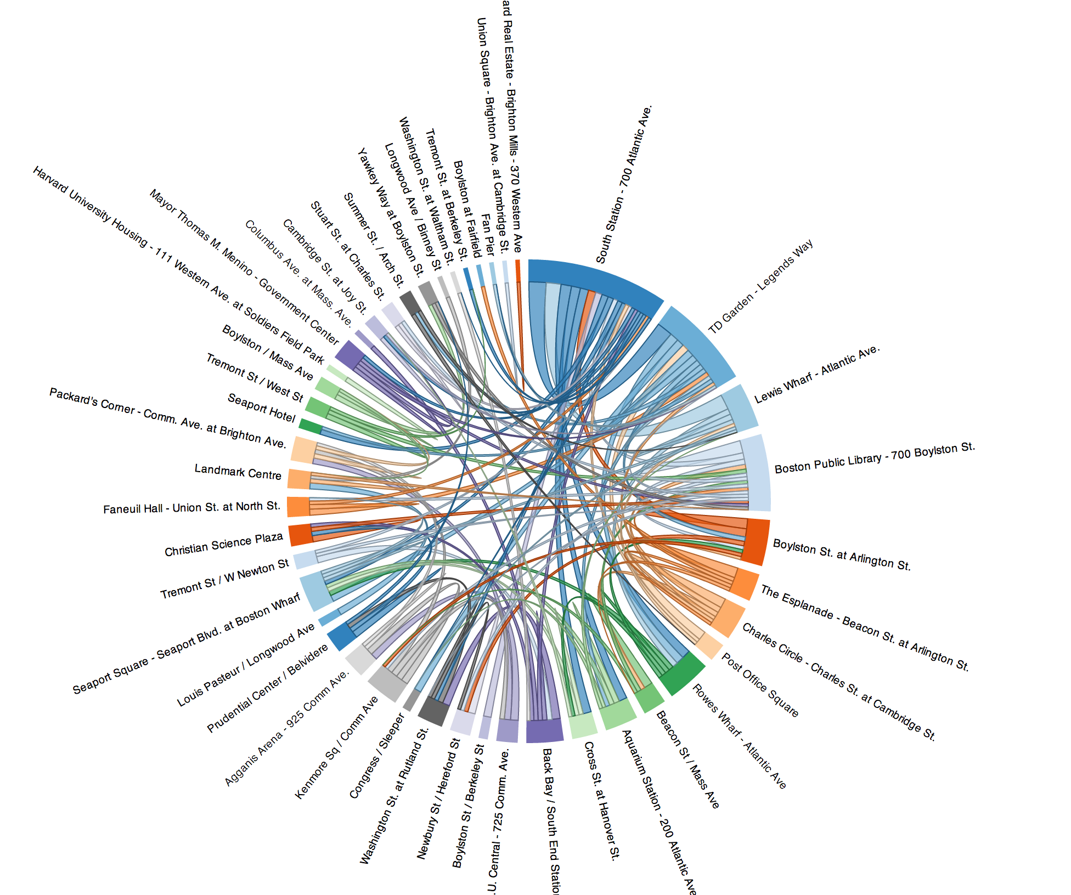
Data Visualization as Art: Theory and Practice
Oleksandr Krakovetskyi
CEO DevRain Solutions
@msugvnua
https://www.facebook.com/alex.krakovetskiy

Slide 2
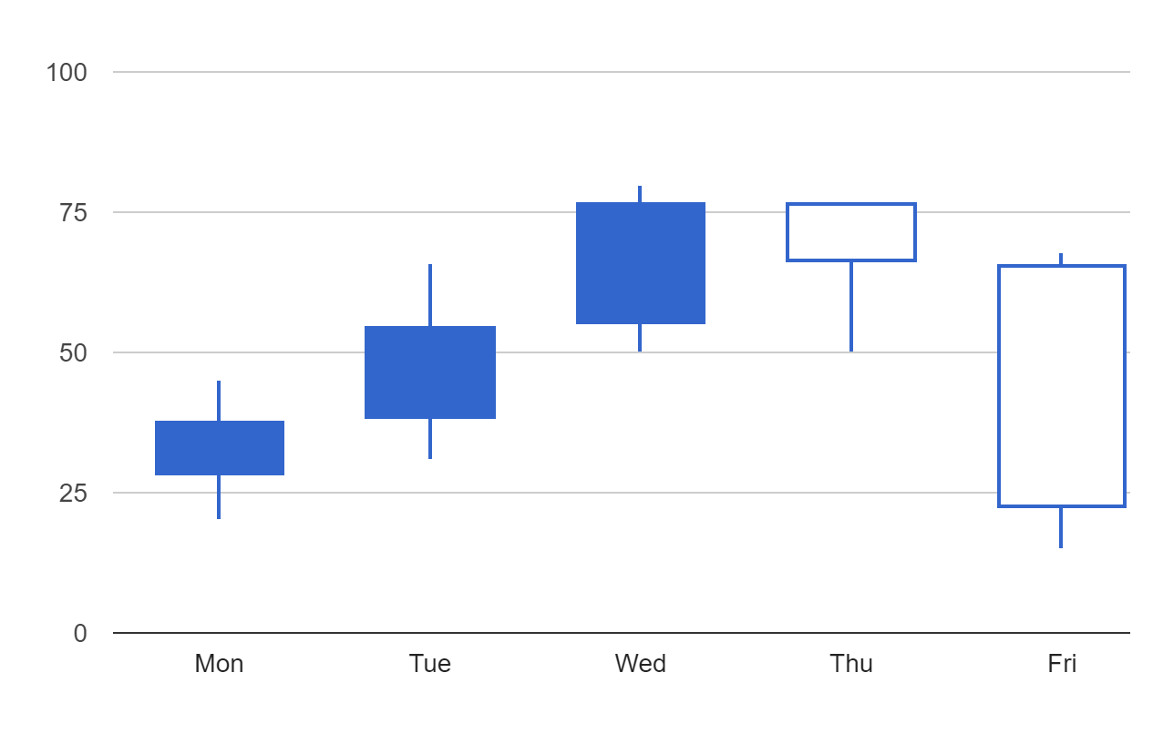
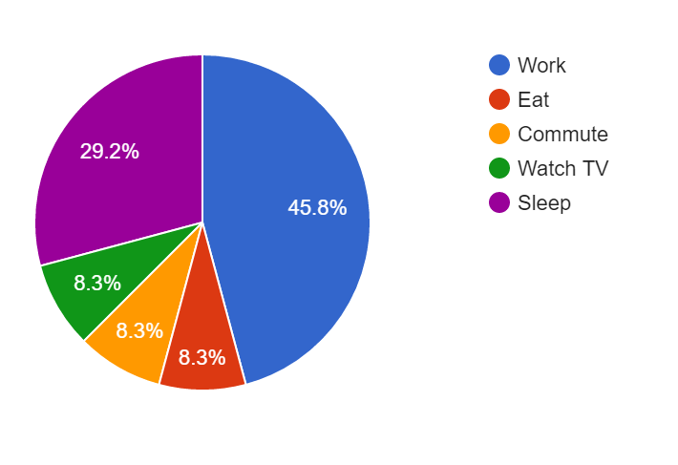
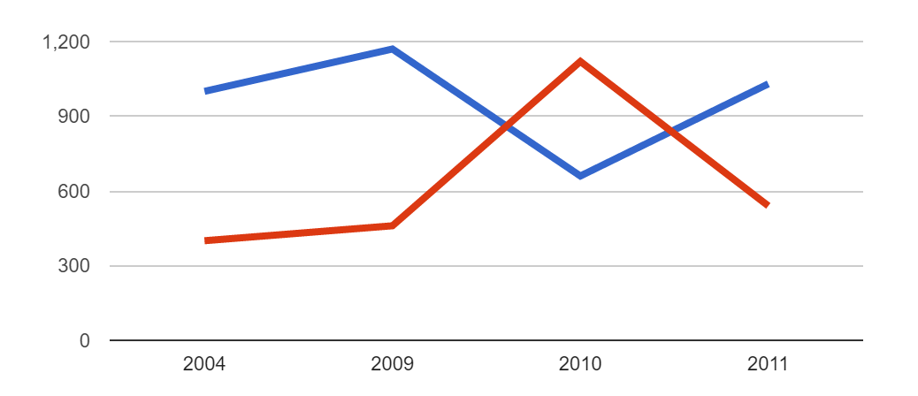
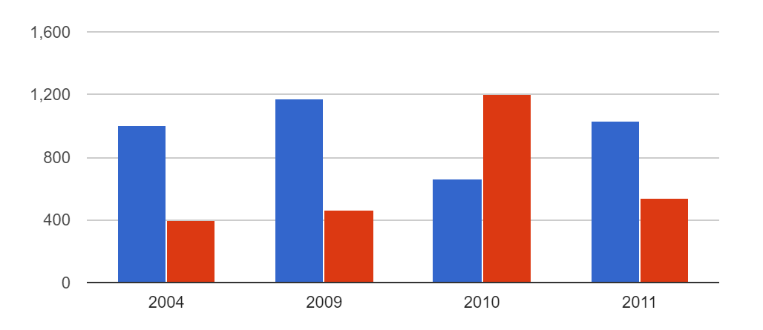
Charts
Bar chart
Column Chart
Combo Chart
Line Chart
Area Chart
Stepped Area Chart
Bubble Chart
Gauge
Candlestick Chart
Histogram
Pie chart

Slide 3
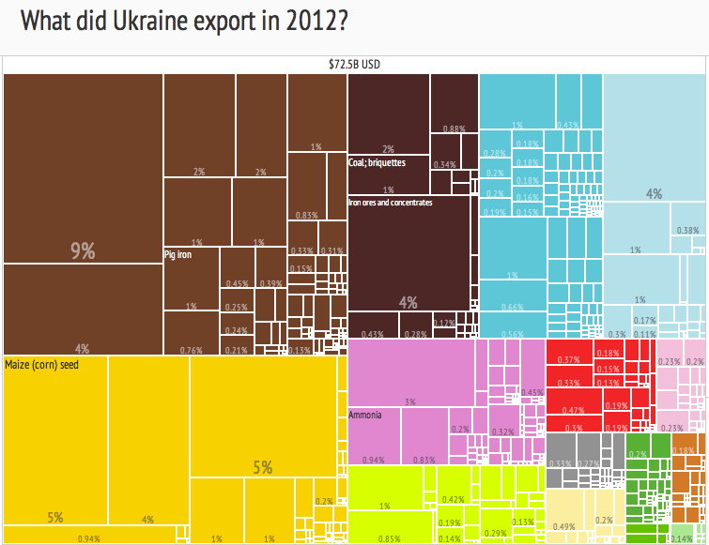
Treemap
A visual representation of a data tree, where each node can have zero or more children, and one parent (except for the root, which has no parents). Each node is displayed as a rectangle, sized and colored according to values that you assign. Sizes and colors are valued relative to all other nodes in the graph.

Slide 4
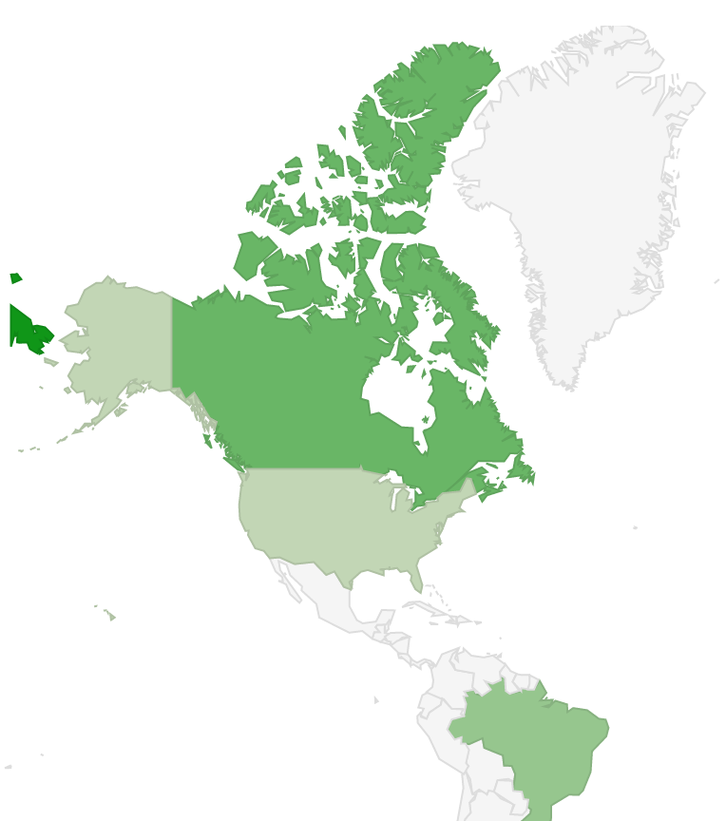
Geochart
Map of a country, a continent, or a region with areas identified in one of three ways:
The region mode colors whole regions, such as countries, provinces, or states.
The markers mode uses circles to designate regions that are scaled according to a value that you specify.
The text mode labels the regions with identifiers.

Slide 5
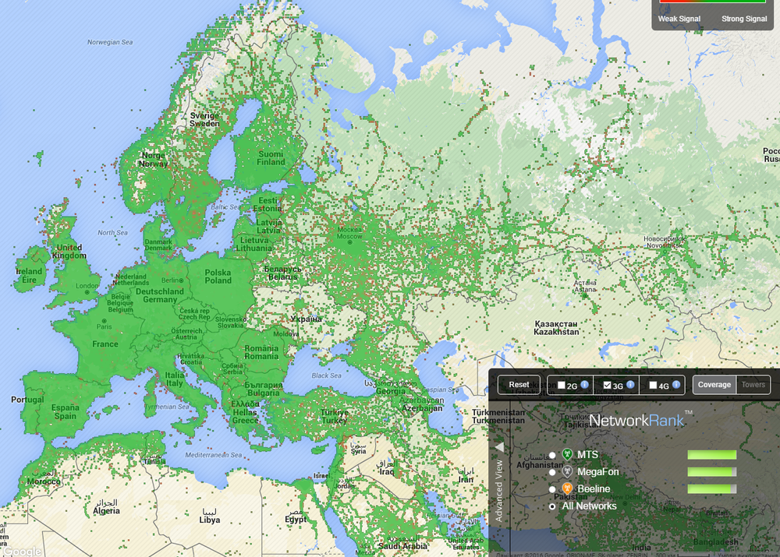
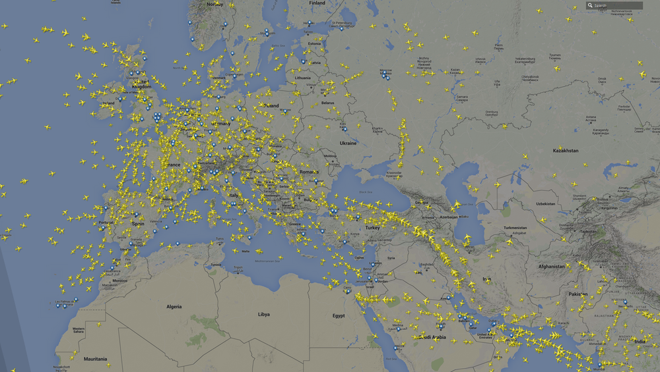
Geochart
3G map
Airlines
http://businessviews.com.ua/ru/studies/id/18-kart-i-grafikov-kotorye-pokazyvajut-realnyj-uroven-razvitija-ukrainy-1087/

Slide 6
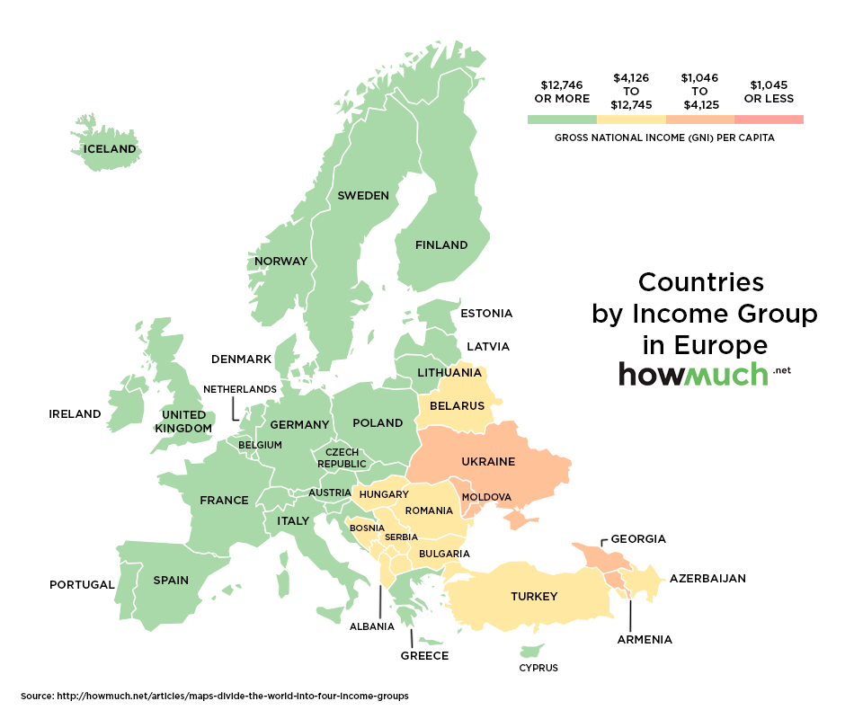
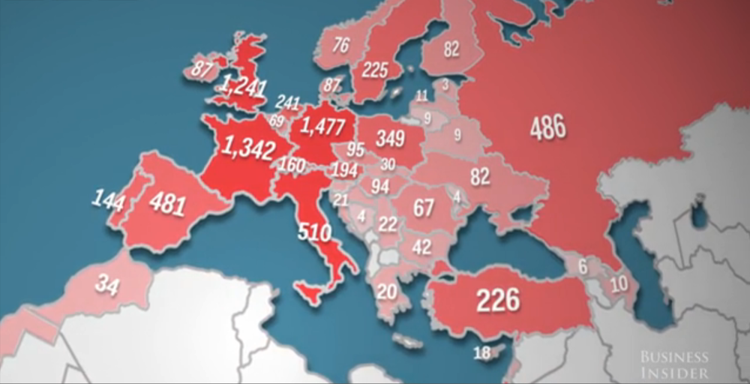
Geo + Heatmaps
A heat map (or heatmap) is a graphical representation of data where the individual values contained in a matrix are represented as colors.
McDonalds
Countries by income

Slide 7
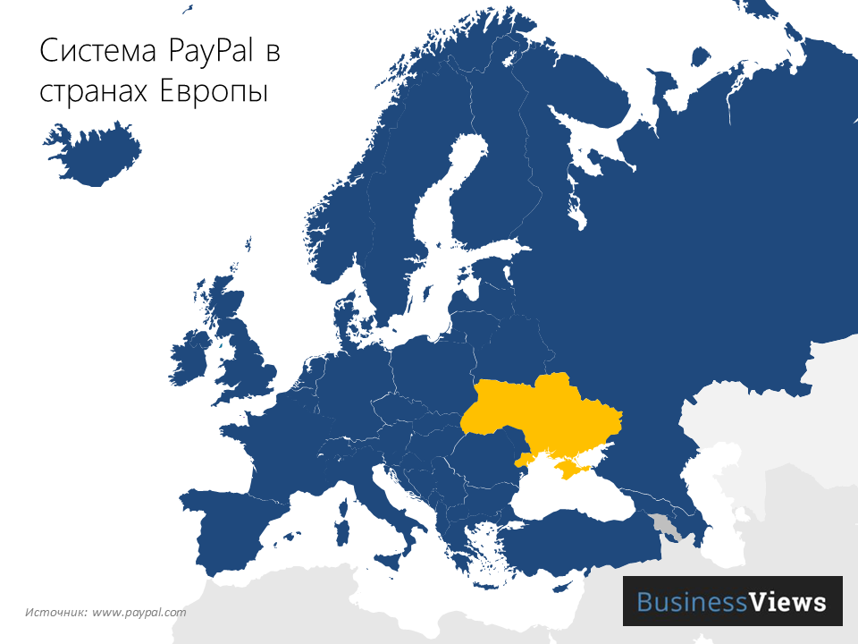
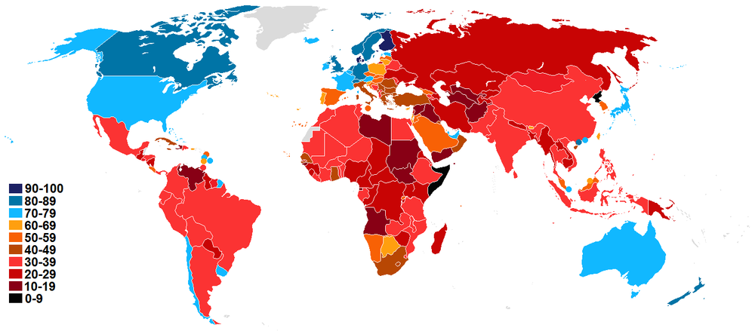
Geo + Heatmaps
Level of corruption
PayPal

Slide 8
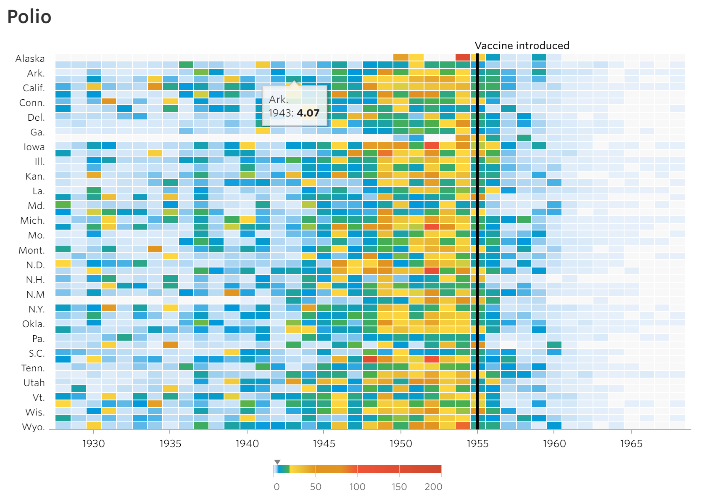
Battling Infectious Diseases in the 20th Century: The Impact of Vaccines
The number of infected people, measured over 70-some years and across all 50 states and the District of Columbia, generally declined after vaccines were introduced. The heat maps show number of cases per 100,000 people.
http://graphics.wsj.com/infectious-diseases-and-vaccines/

Slide 9
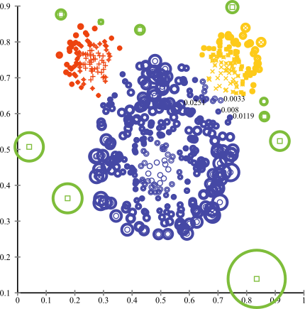
Anomaly detection
In data mining, anomaly detection (also outlier detection) is the identification of items, events or observations which do not conform to an expected pattern or other items in a dataset.

Slide 10
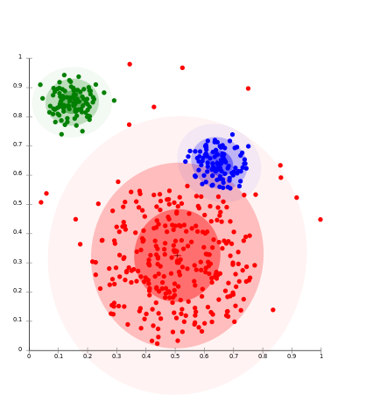
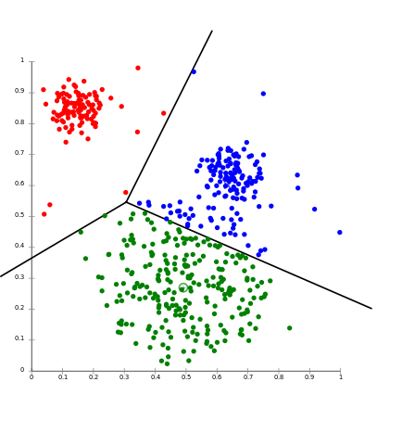
Clustering
Cluster analysis or clustering is the task of grouping a set of objects in such a way that objects in the same group (called a cluster) are more similar (in some sense or another) to each other than to those in other groups (clusters). It is a main task of exploratory data mining, and a common technique for statistical data analysis, used in many fields, including machine learning, pattern recognition, image analysis, information retrieval, and bioinformatics.

Slide 11
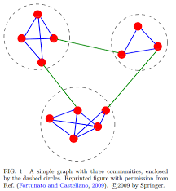
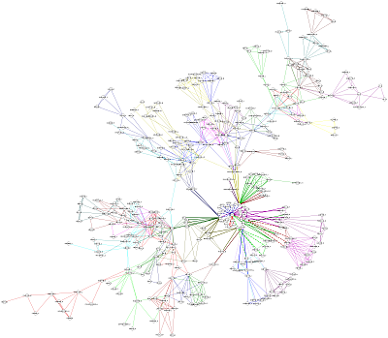
Communities

Slide 12
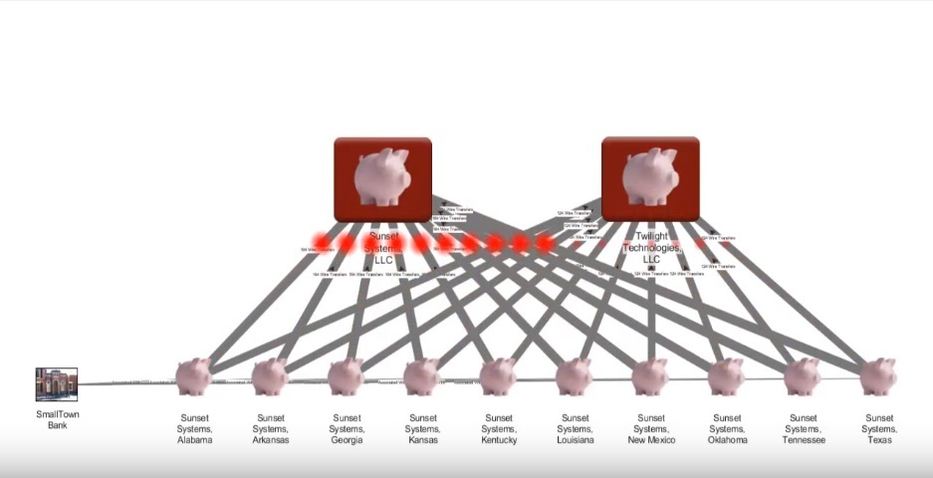
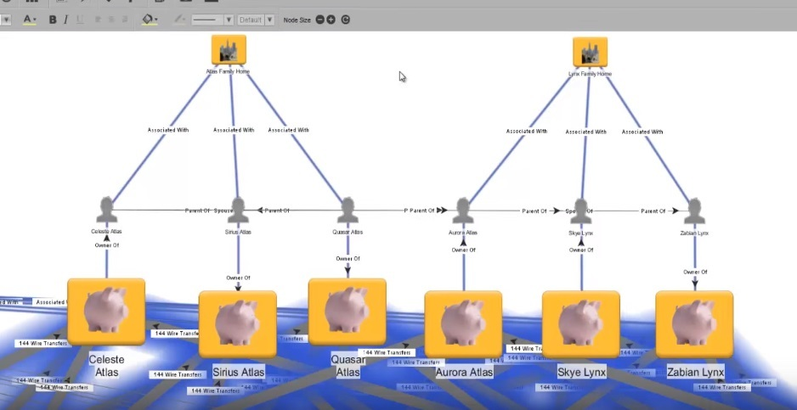
Palantir
https://habrahabr.ru/company/edison/blog/280434/

Slide 13
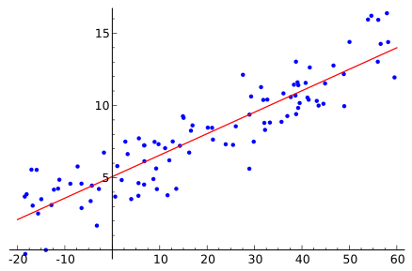


Regression
In statistics, regression analysis is a statistical process for estimating the relationships among variables.
Regression analysis
Neural networks

Slide 14
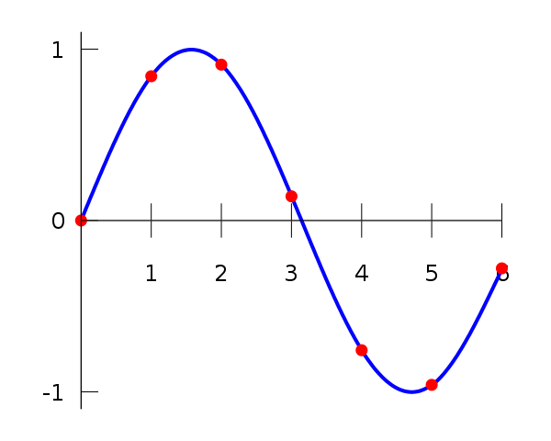
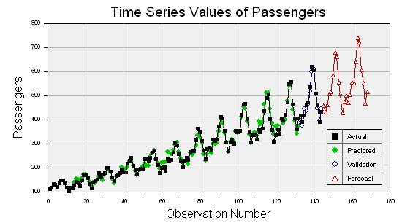
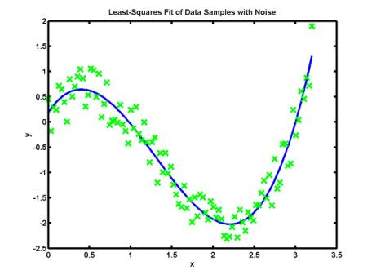
Regression
Interpolation
Approximation
Extrapolation (time series)

Slide 15
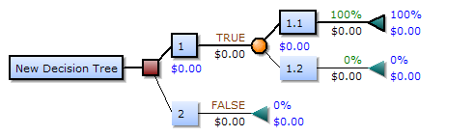
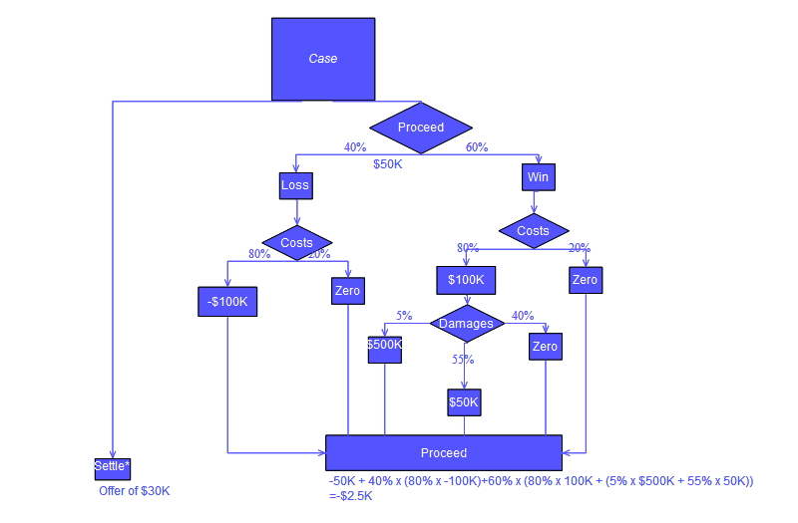
Decision Trees
Uses a decision tree as a predictive model which maps observations about an item to conclusions about the item's target value.

Slide 16
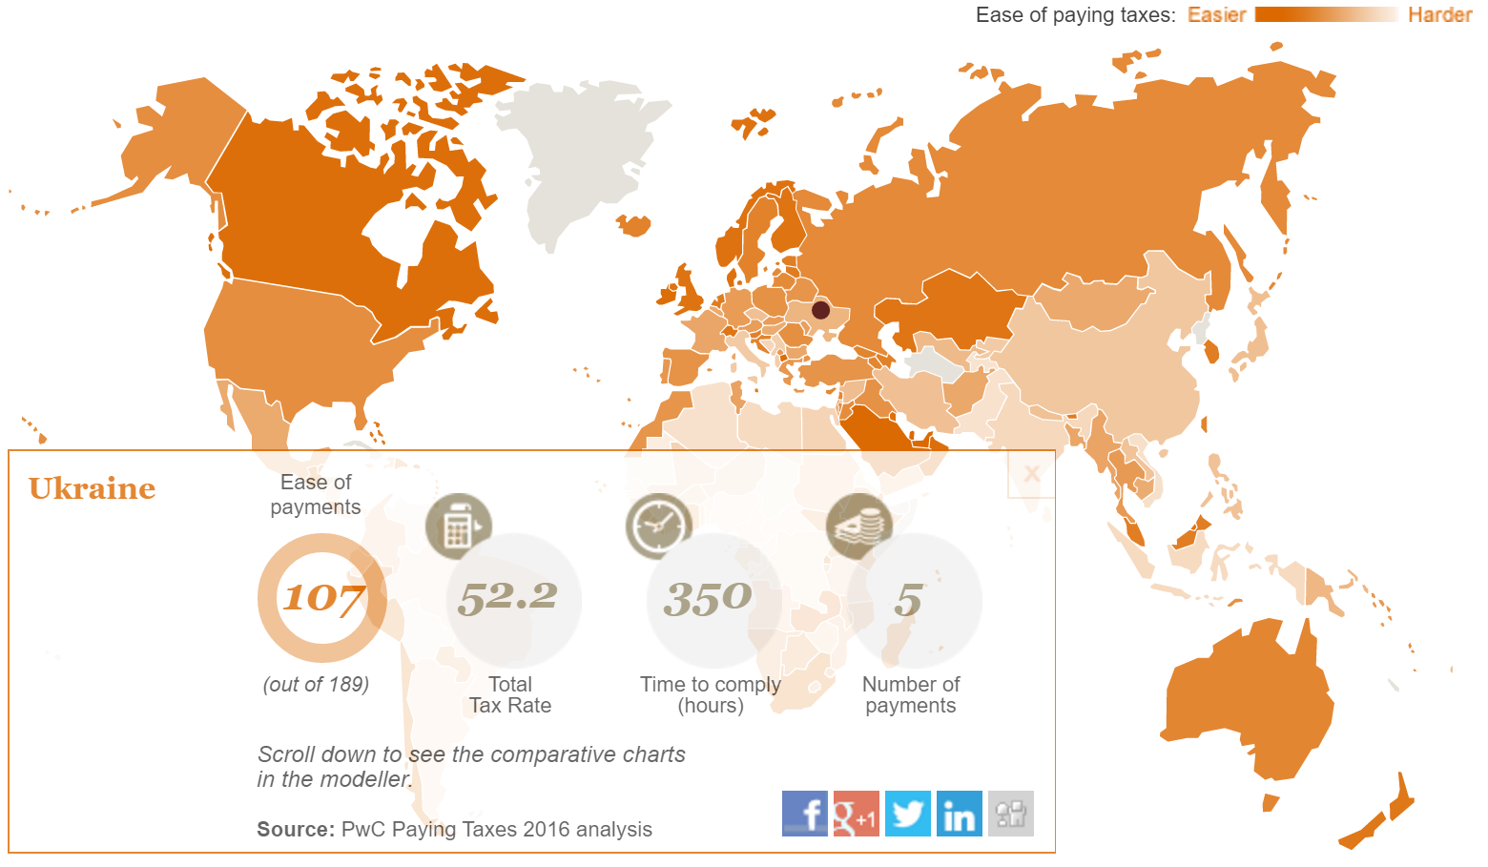
Paying Taxes 2016
Explore our powerful interactive data modeller and watch the data unfold on business tax systems across 189 global economies.
http://www.pwc.com/gx/en/services/tax/paying-taxes-2016/comparative-modeller.html

Slide 17

Питання?
Олександр Краковецький
CEO, DevRain Solutions
Експерт Державного агентства з питань електронного урядування України при підтримці ПРООН
alex.krakovetskiy@devrain.com
https://www.facebook.com/alex.krakovetskiy
@msugvnua

